Slide 1
Keypom x NEAR China
Instant crypto experiences
July 18th, 2023

Slide 2
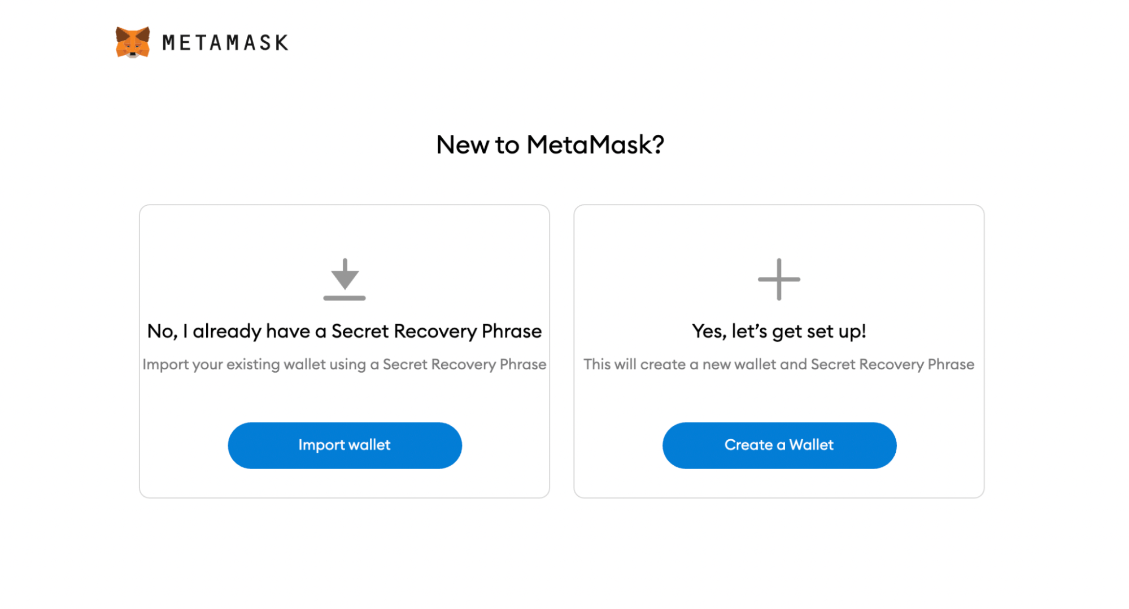
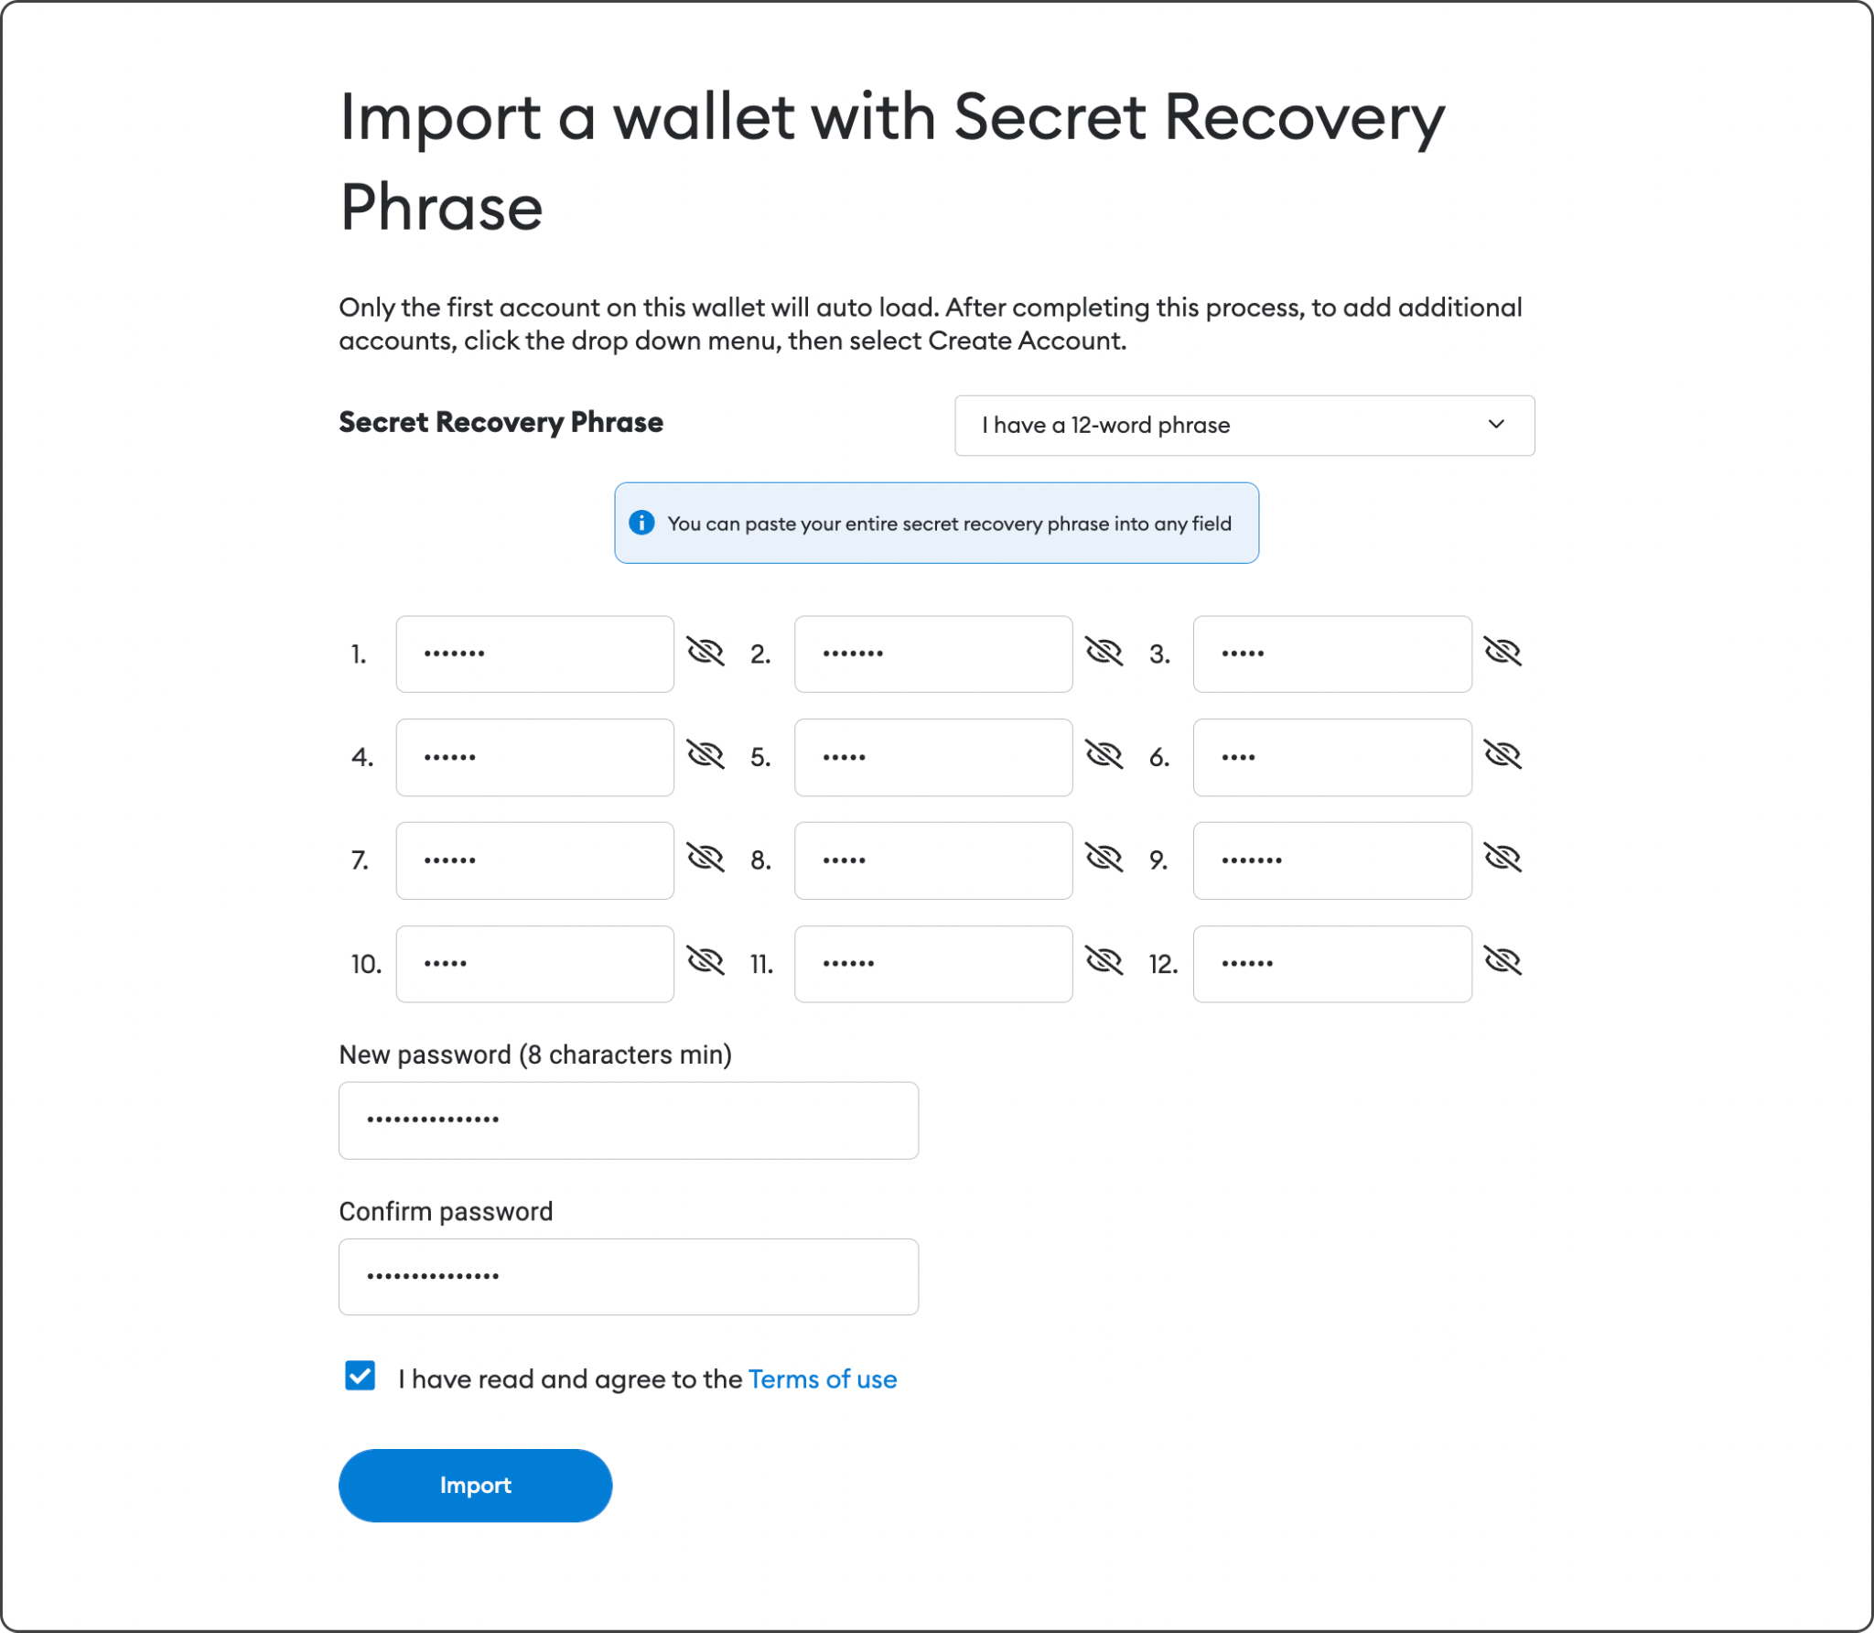
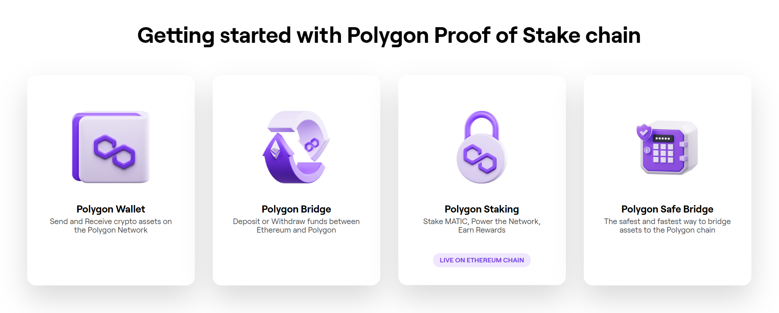
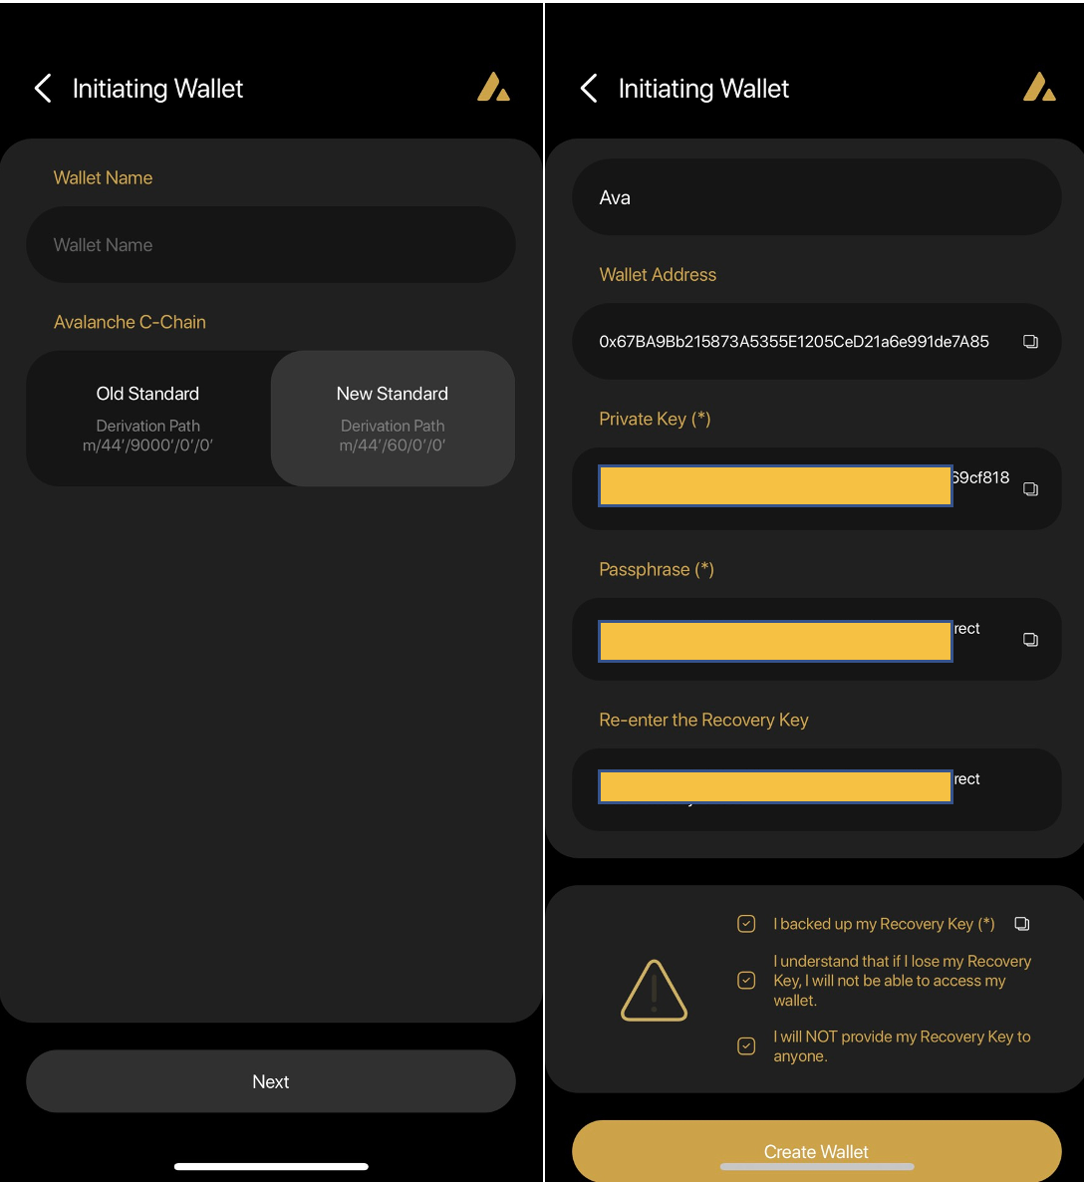
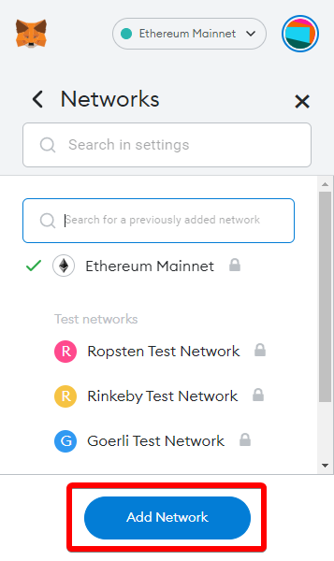
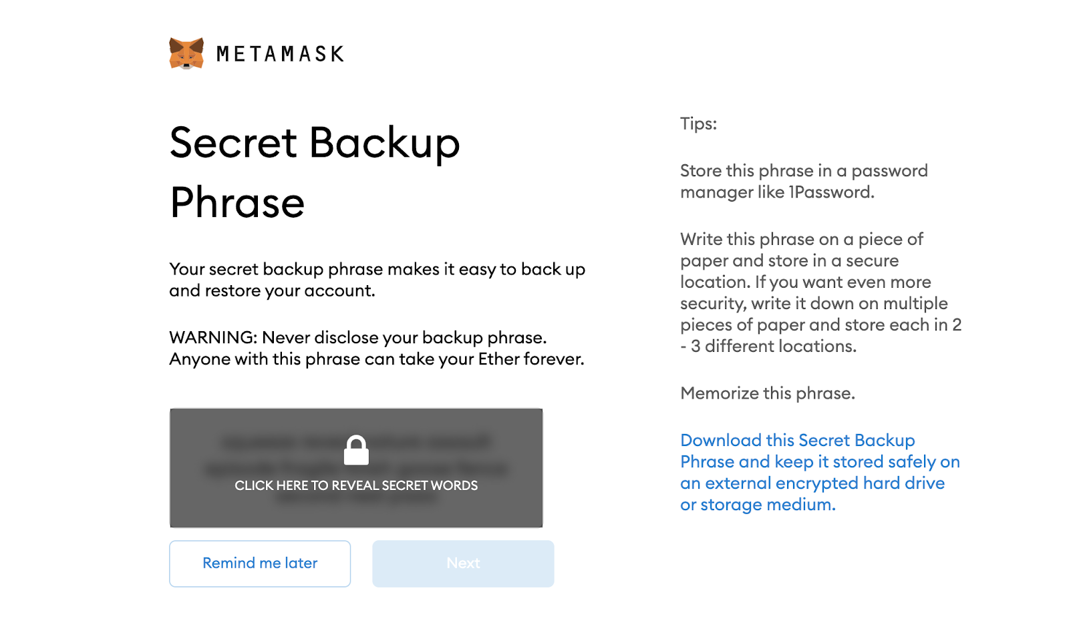
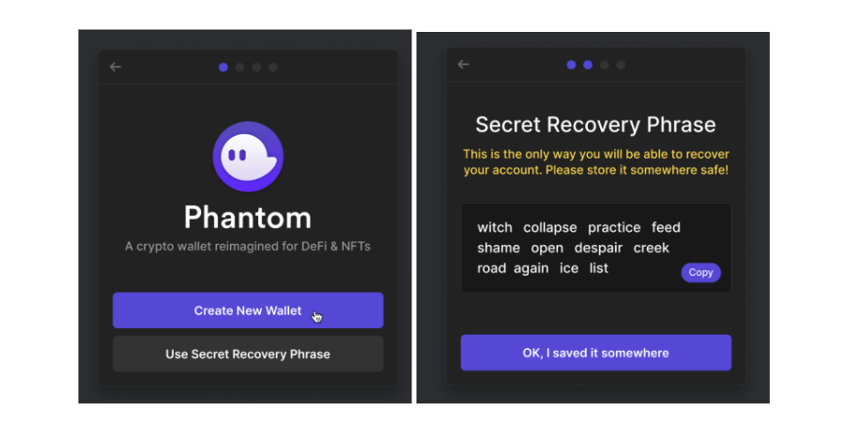
Current Crypto Experiences
Problem: High barrier to entry that do not put user experience first!
Onboarding before dApp experience
Painful onboarding
Rugging during onboarding discourages developers from creating free trials
Users and Developers lose out!

Slide 3
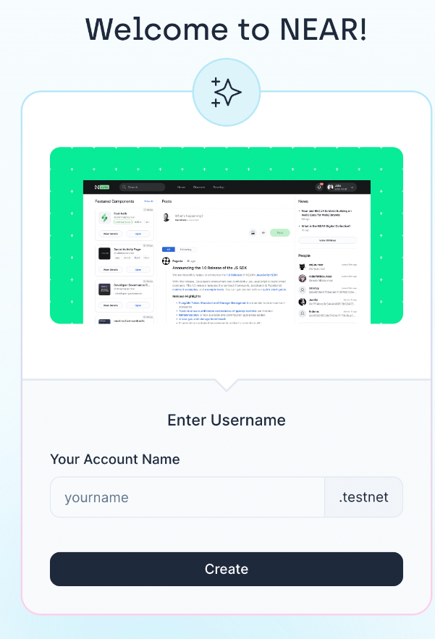
Keypom in a Nutshell
Instant Crypto Experiences
Put the experience first, users onboard after
More akin to Web2 experience:
Land on page, Use app, Sign up
Unlock more use cases across ecosystem
NEARCON 2023 and NEAR APAC Ticketing
ShardDog + Affiliated projects
Refi, NEARWEEK, BluntDAO
Veriken
Coingecko 20k NFT Raffle

Slide 4
Core Keypom Concepts
The core concepts to Keypom

Slide 5

Core Keypom Concepts
NEAR Access Key Model (Account Abstraction):
Key is not tied to an account and are used to sign transactions
Limited Access Keys is a restricted key only capable of calling certain functions on certain contracts
Keypom LAKs can only call claim on the Keypom contract!
Keypom Terminology
Key: access key created by Keypom - this is distributed to users, which they will use to claim
Drop: a collection of keys that all share the same properties
Funder: user who creates and funds the drop
Original Moon!

Slide 6
Case Study 1: Automatic DAO Registration
Real World Example: ShardDog x BluntDAO

Slide 7

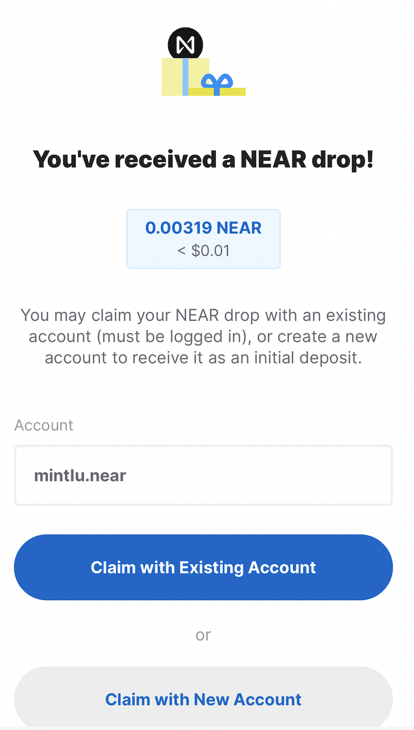
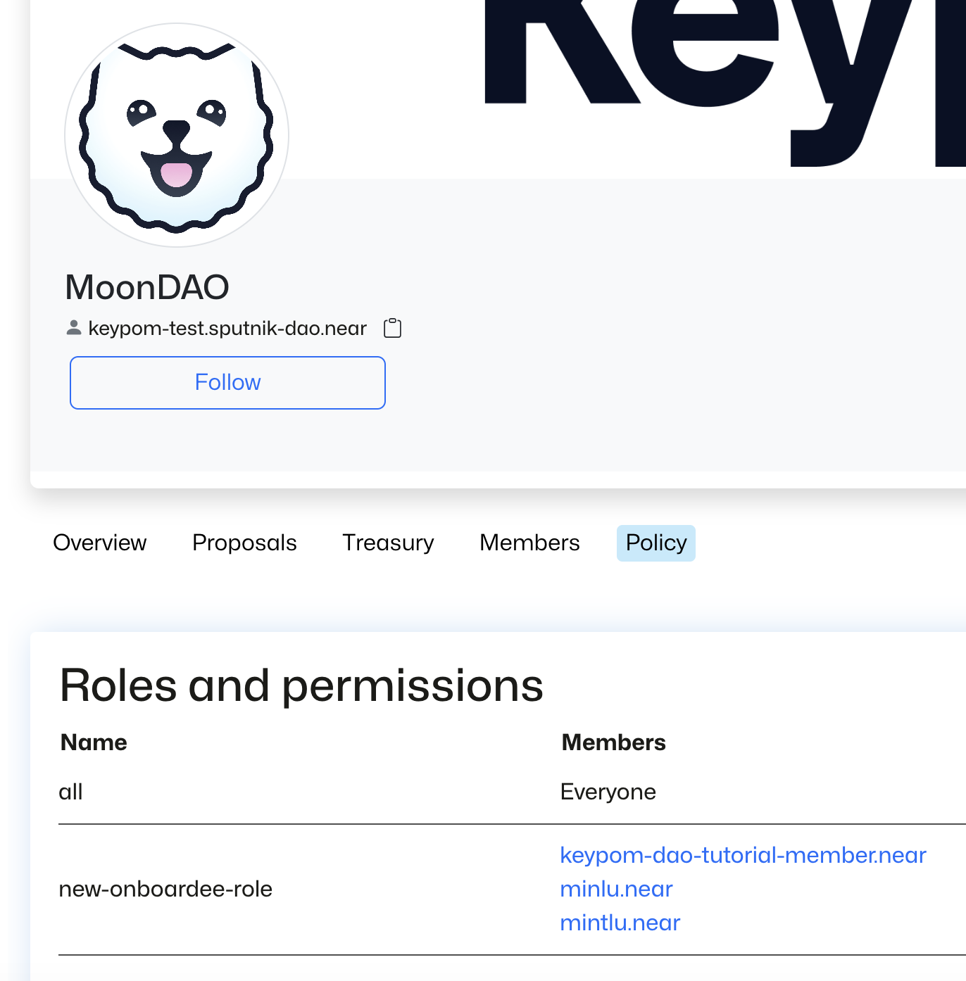
Auto DAO Registration - User Flow
Traditionally:
An interested user must create a wallet; introducing seed phrases, KYC etc.
With an account, they create a proposal to join a DAO
A user’s membership into the DAO is then stuck waiting for a voting quorum to approve their proposal
Only after a quorum is reached, are they registered in the DAO
Supercharged with Keypom:
An interested user clicks a link,
INSTANTLY they are registered into the DAO and receive an NFT, regardless if they have a wallet
Auto-registration campaigns require council approval and can be human-gated using I-Am-Human

Slide 8
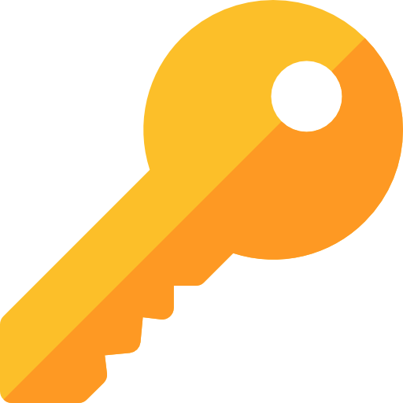
Auto DAO Registration - How?
Asset Loading!
Add NFTs, FTs, Function Calls, and NEAR to your drops
When keys are claimed, these assets are transferred to the claiming account
In this case two assets are loaded
Function call: 1 call to the DAO through a proxy
1 NFT
Upon claiming, the NFT is transferred and the DAO is called

Slide 9
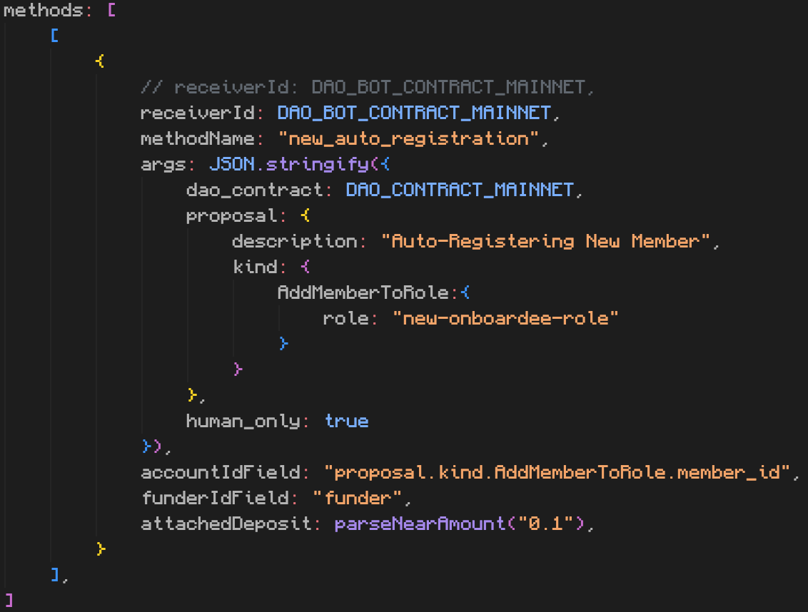
Auto DAO Registration - Function Call
Other assets are more straightforward but how does one “load” a Function Call?
Function call assets are mostly predefined and limited only by the NEAR protocol 300TGas limit
You can multiple Function Calls as you want into each key use
As the drop creator, you define:
Target/receiver contract
Method name
Arguments (as JSON)
Gas + Deposit
You can also accept user arguments, and include other security measures
Keypom Injected Arguments cannot be spoofed!

Slide 10

How can you learn more?
!!DOCS!!
DAO Auto-Registration
Tutorial
Ticketing Tutorial
Other Basic Tutorials

Slide 11
Case Study 2: Trial Accounts
Real World Example: NEAR Horizon

Slide 12
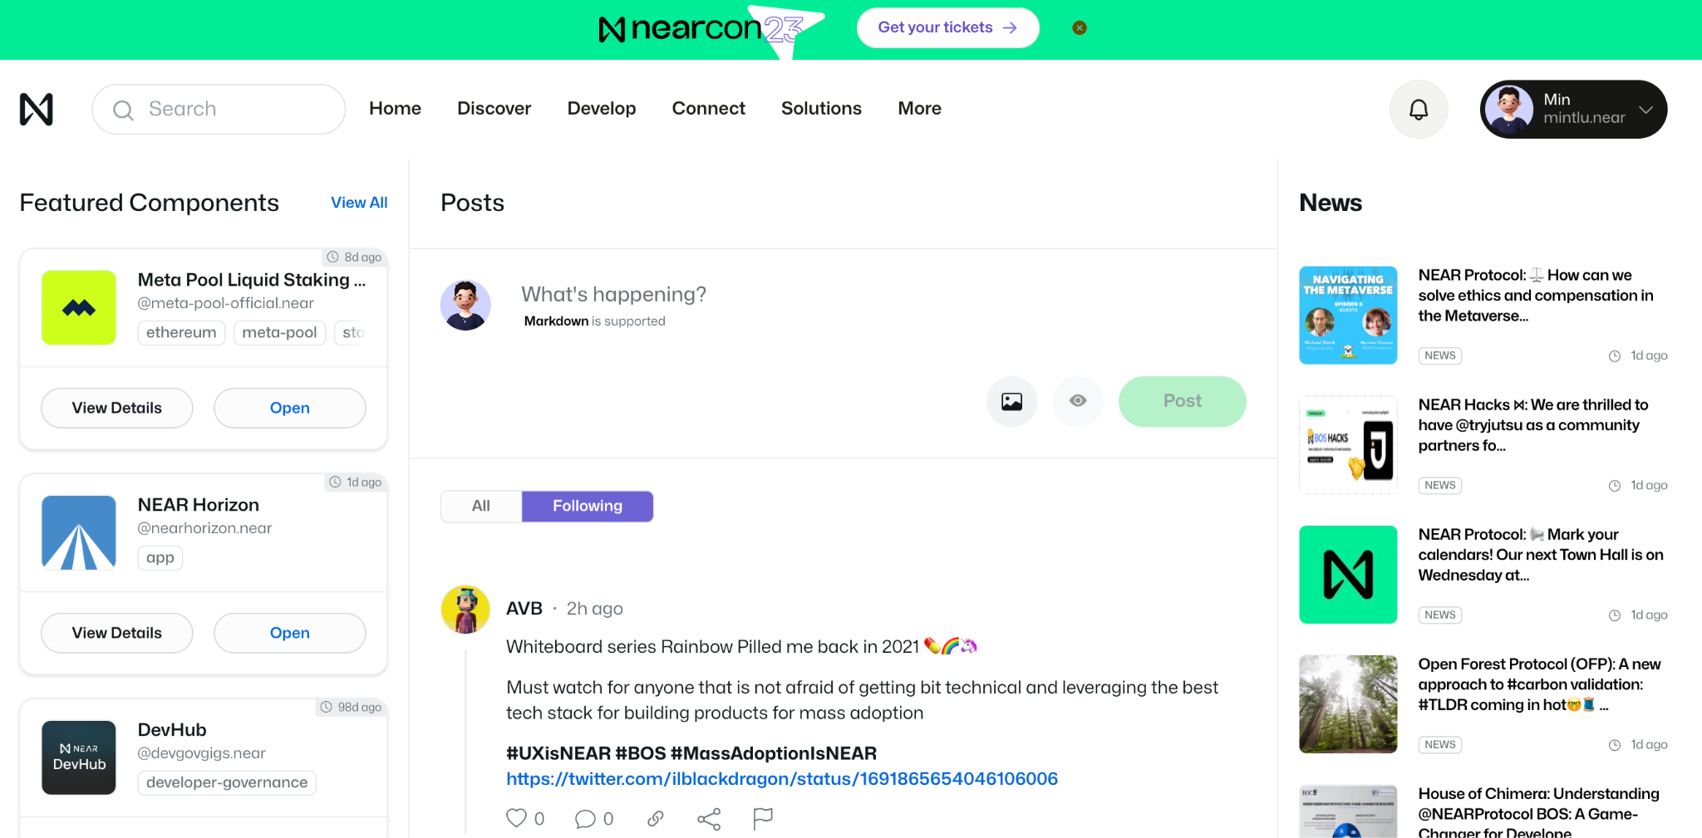
Trial Accounts - User Flow
Traditionally:
Developers give out pre-funded wallets for users to try their dApp
Users can rug the developers as funds are unrestricted
OR
Users must have or create a wallet just to try a dApp…
Supercharged with Keypom:
User lands on dApp and picks a username
INSTANTLY start using the dApp
No fear of developers being rugged, 100% of funds will go to intended purpose!!

Slide 13
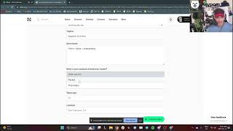

Slide 14

Trial Accounts - How?
Web3 gift card:
Users get a no-risk trial of your dApp
You have 100% certainty that the trial funds can ONLY be used on your dApp
The developer has full control of all aspects of this trial
Trial account = new account with a small proxy contract deployed!
This account only has a LAK to call this proxy.
The trial restrictions live on the proxy contract!

Slide 15
How can you learn more?
Trial Accounts Tutorial

Slide 16
Case Study 3: NFT Access Key Ticketing
Real World Example: NEARCON 2023, NEAR Toronto Hub Launch
Under Development👀

Slide 17
NFT Access Key Ticketing
User buys a ticket with FIAT
Access Key ↔ NFT
Every NFT ticket is linked to and controlled by one swappable Access Key.
User can buy tickets, attend, earn/spend at the event, redeem their event assets or sell their tickets all without a wallet
No comparable experience - Ticketing + Account Abstraction is new!
Sell their ticket and receive funds from sale
without a wallet
Enter the event using the QR code
Participate in an on-the-ground on-chain economy
without a wallet
After the event, the attendee can move their assets into their account

Slide 18
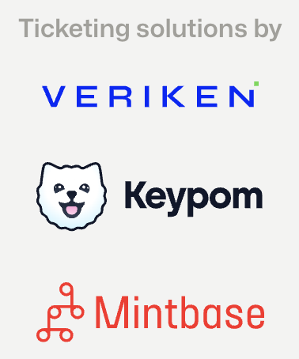
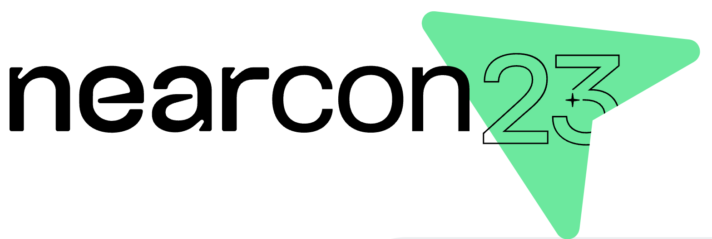
NFT Access Key Ticketing - How?
Each key is now associated with an NFT - which means you can trade, sell, and expand these access keys + NFTs without a wallet!
Selling a ticket simply swaps out the Access Key that an NFT is associated to
This selling/swapping can be price-protected
Funds from sale go to owner OR a linkdrop
Attaching a trial account experience to each key
create on-the-ground and on-chain experiences for attendees without typical crypto jargon

Slide 19
How can you learn more?
👀Keypom V3👀

